Slide 1

Comparing to human-level performance
Understanding human-level performance
deeplearning.ai

Slide 2
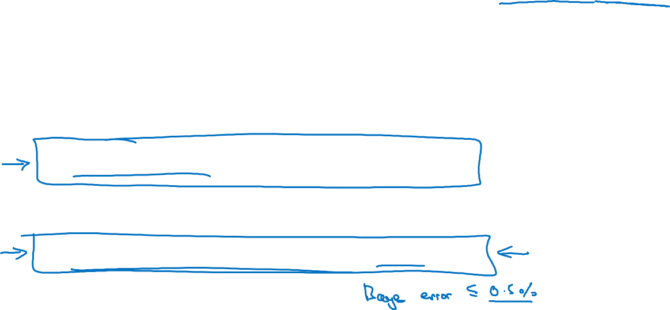

Human-level error as a proxy for Bayes error
Medical image classification example:
Suppose:
(a) Typical human ………………. 3 % error
(b) Typical doctor ………………... 1 % error
(c) Experienced doctor …………... 0.7 % error
(d) Team of experienced doctors .. 0.5 % error
What is “human-level” error?

Slide 3
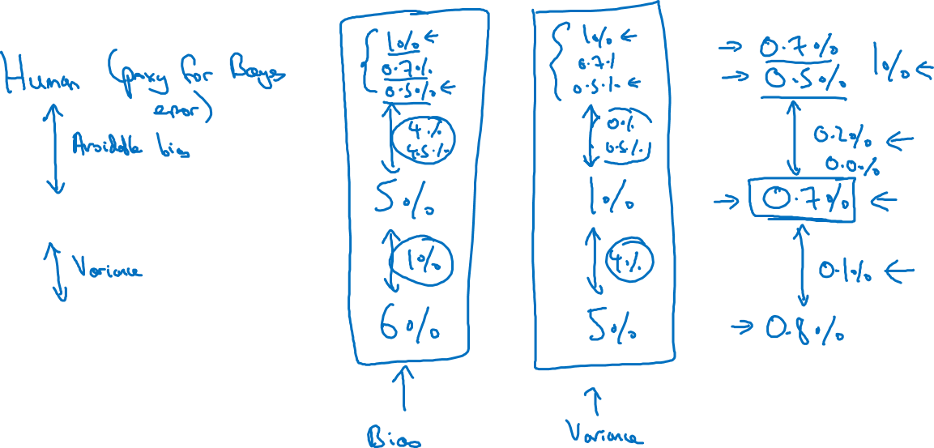
Error analysis example
Training error
Dev error

Slide 4
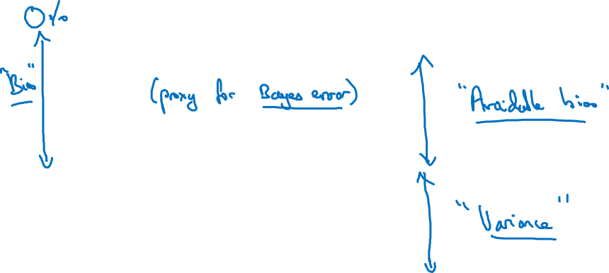
Summary of bias/variance with human-level performance
Human-level error
Training error
Dev error

